Slide 1

TRENDS & INSIGHTS
Castro Ambiyo
Gravity Plus

Slide 2
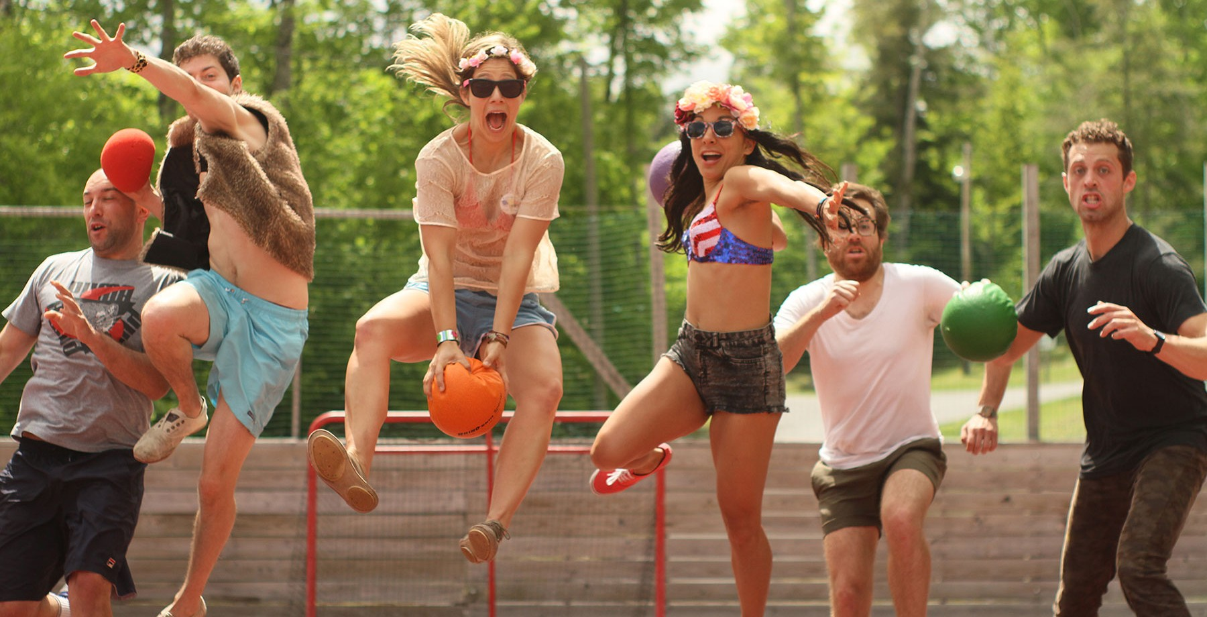
Suspended Adulthood
Millennials look to put a pause on adult life with youthful experiences
Adult Summer Camps
Camp No Counselors Invites Grown-Ups to Enjoy Youthful Freedom with Booze

Slide 3

Enlightened Rebellion
Today's teens take a stand against conventional stereotypes
Gender-Neutral Fast Fashion
The Ungendered Line from Zara Can Be Worn by Anyone

Slide 4
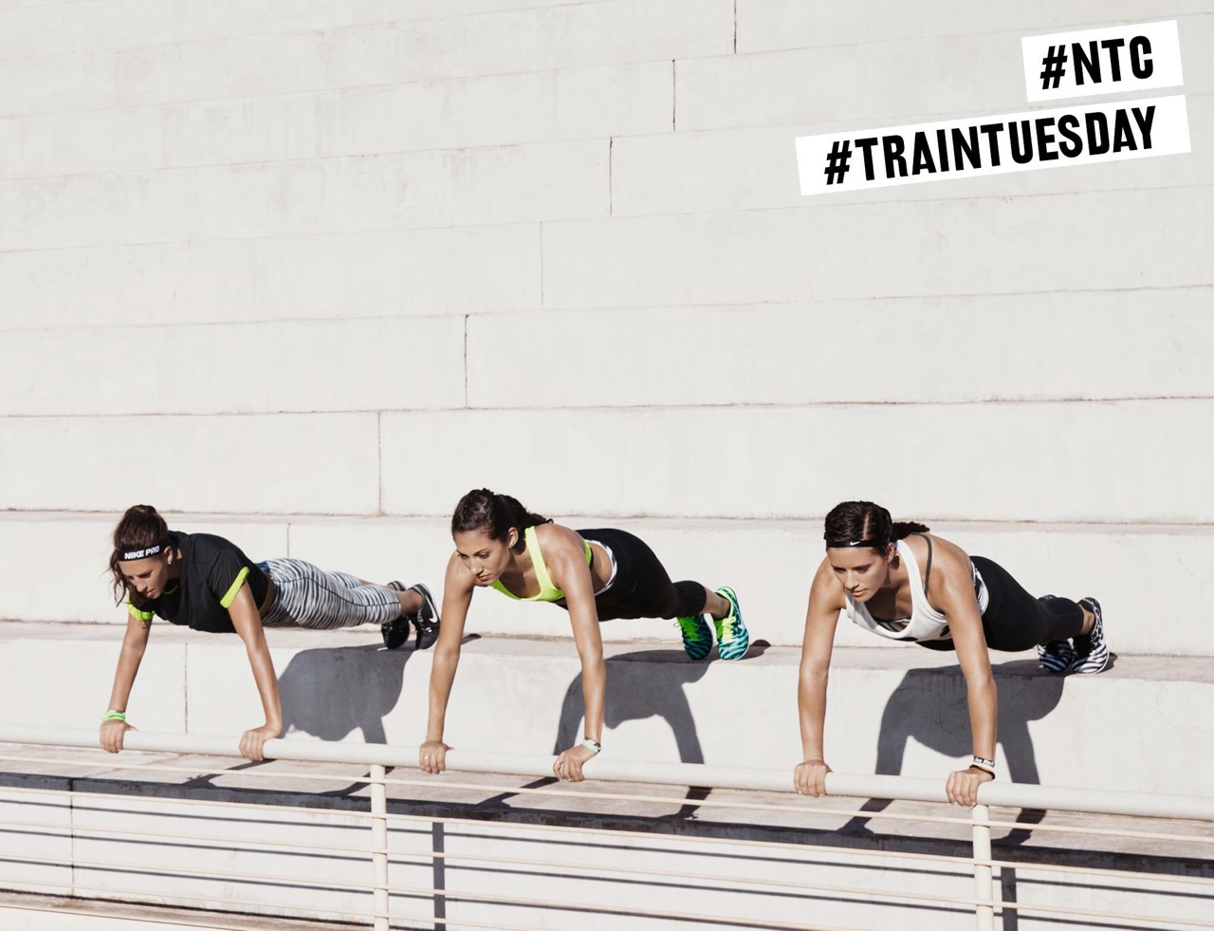
Instagrammable Everything
Socially driven consumers embrace workouts that also offer photo opps
Floating Fitness Studios
The Nike Crystal Coliseum was a Pop-Up for Training Classes

Slide 5
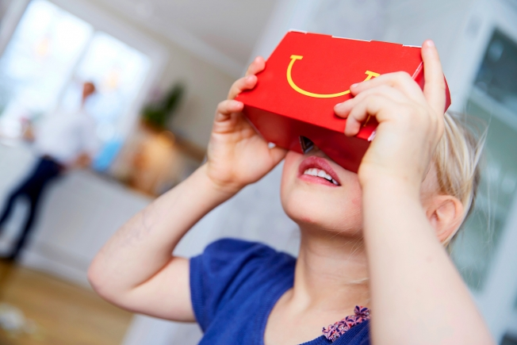
Embedded VR
Brands activate virtual reality users with headset-embedded packaging
Kids Meal VR Packaging
McDonald’s Sweden Creates a Happy Meal Box VR Headset

Slide 6
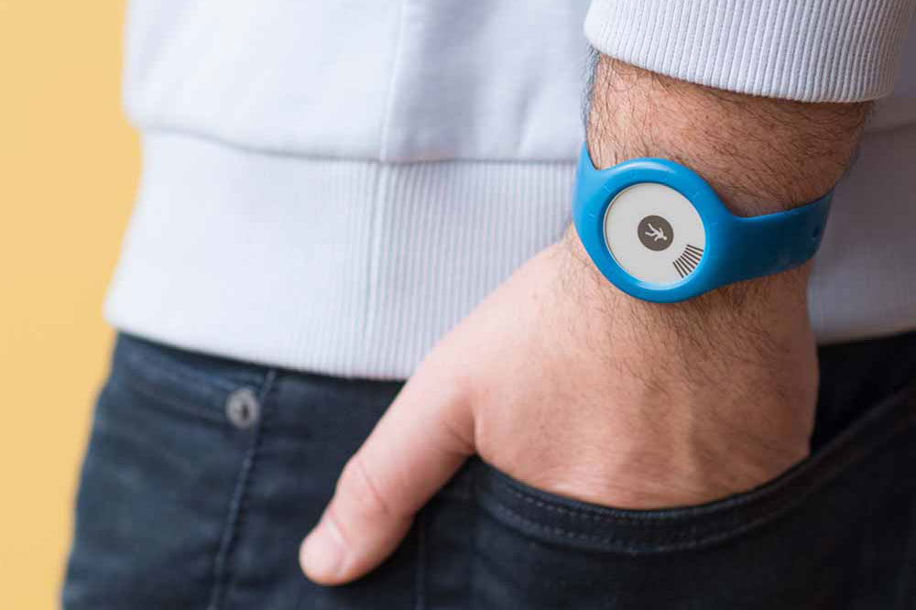
Quantified Self-Care
Consumers collect information about their personal care habits
Simplistic Fitness Trackers
The Withings Go Fitness Tracker Displays a Sleek and Minimal Design

Slide 7
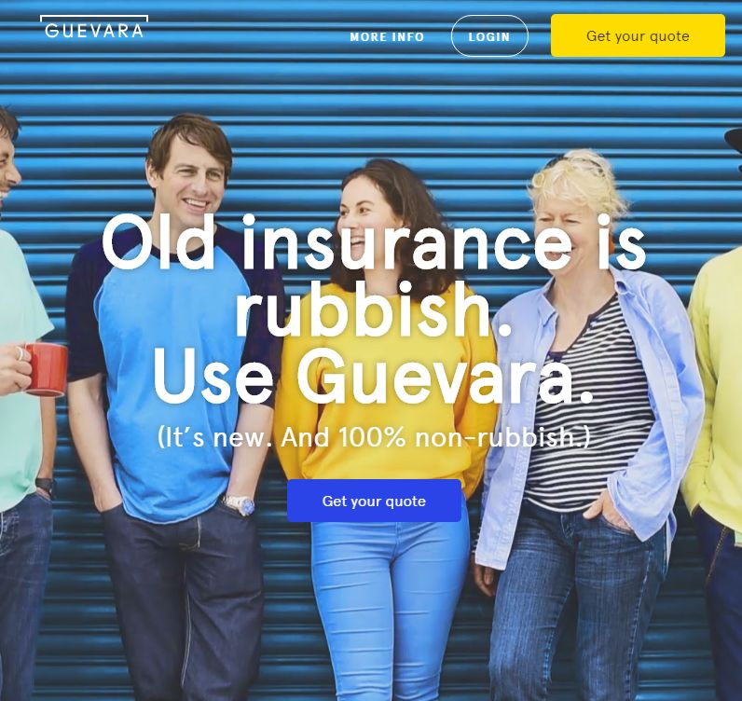
Democratized Milestone
Big-ticket items become a part of sharing culture
P2P Car Insurance
Guevara Lets Groups Share Insurance in Order to Keep Claims Low

Slide 8
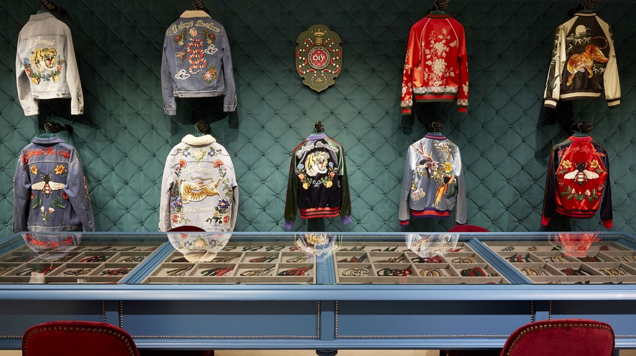
Designer Customization
Fashion brands add kiosks in-store that allow post-purchase personalization
Luxury Clothing Customizations
Gucci is Allowing Consumers to Do DIY Modifications In-Store

Slide 9
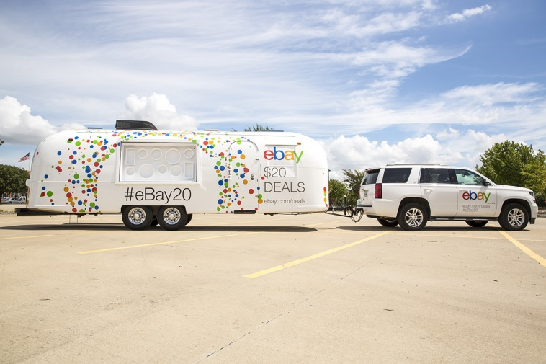
Analog Divergence
Digital brands take advertising offline with traditional mediums
E-Commerce Birthday Road Trips
The eBay 20th Anniversary Airstream Trailer Showcased Deals

Slide 10
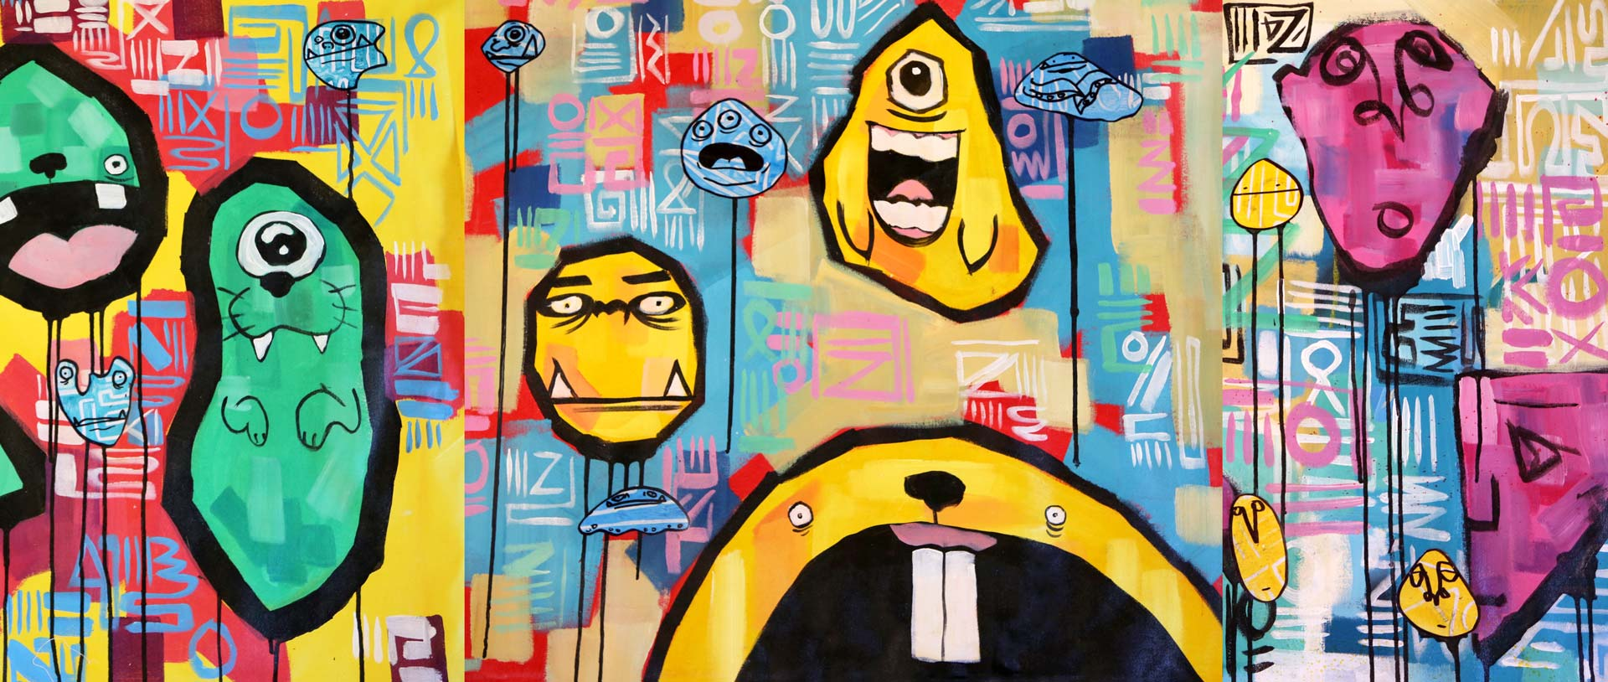
Maker Families
Millennial parents join kids in hands-on DIY workshops
Kid-Friendly Graffiti Classes
4CATS' 'Express Yo Self' Seminars Teach Children Street Art Tricks

Slide 11
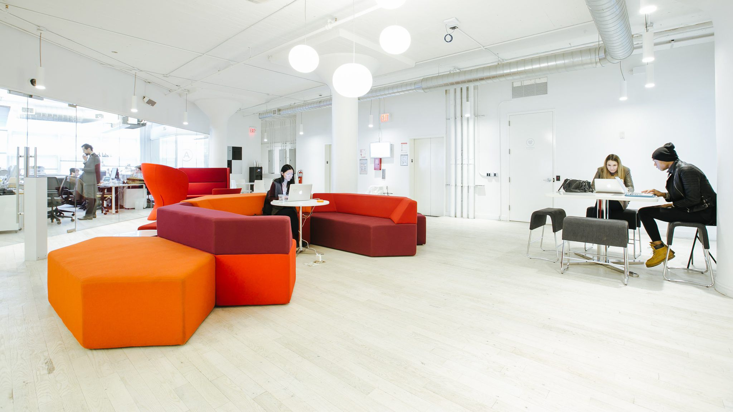
Communal Living
Millennials find a sense of community, meaning & a way to cost-cut
Urban Co-Living Spaces
Startup 'WeWork' is Testing a New York Co-Living Building Called 'WeLive'

Slide 12

Branding Secrecy
Food brands unveil new offerings in a multi-step process
Secret Fast Food Fares
Chick-Fil-A Offers a Decadent Array of Secret Meals in NYC

Slide 13
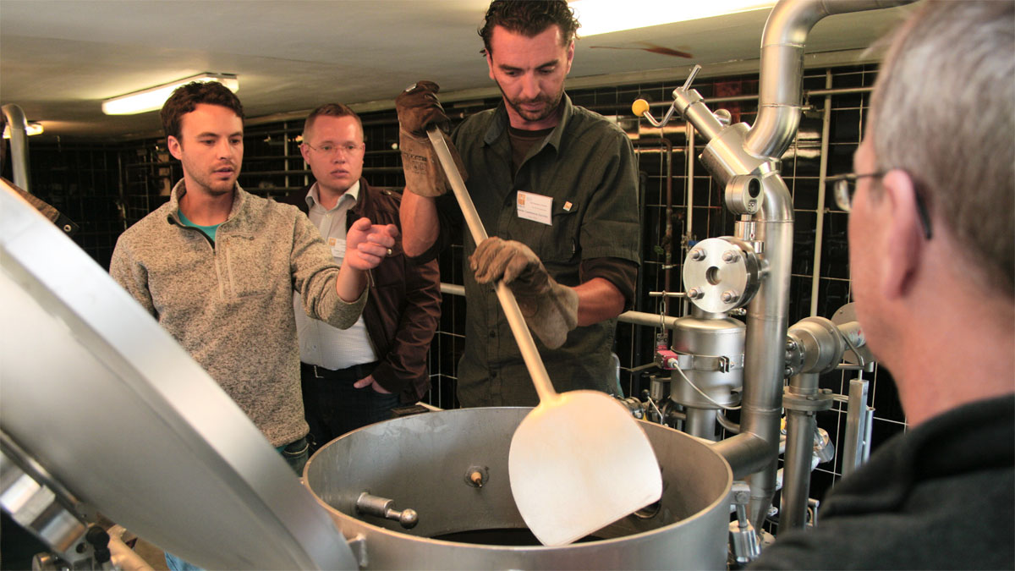
Artisanal Education
Consumers seek out niche workshops to gain artisan-level knowledge
Beer Brewing Workshops
These Events Give Consumers an Opportunity to Learn About Homebrewing

Slide 14
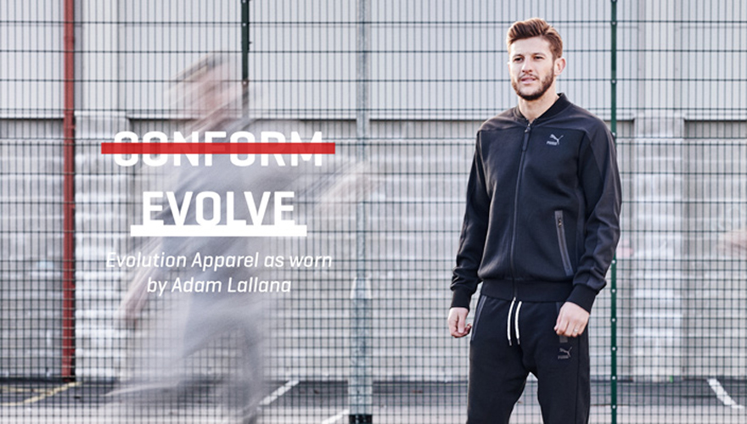
Shoppable Media
Retailers offer purchasing options in entertainment pieces for convenience
Shoppable Athletic Videos
In Partnership with Smartzer, Puma Makes It Possible to Shop a Video

Slide 15
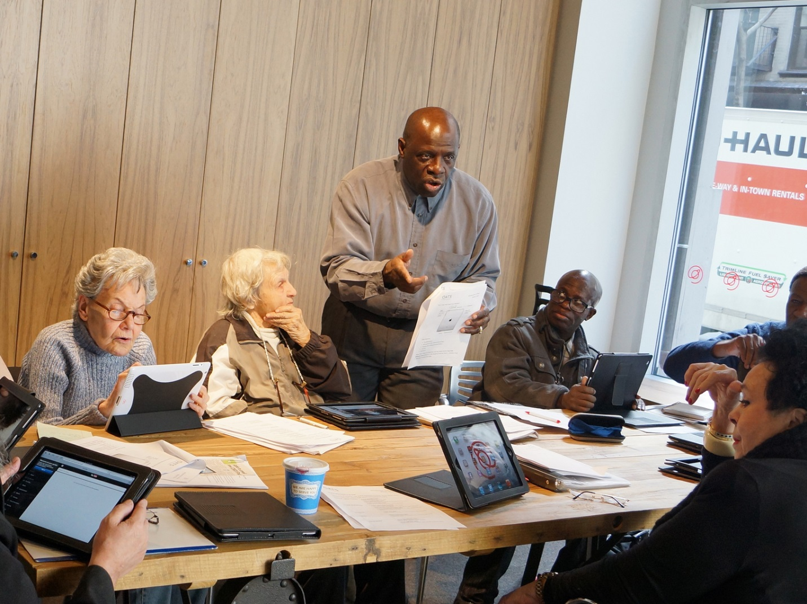
Elderly P2P
Sharing economy initiatives take aim at social issues facing seniors
Senior Co-Working Spaces
'Senior Planet' Offers Classes and Workshops for People 60+

Slide 16
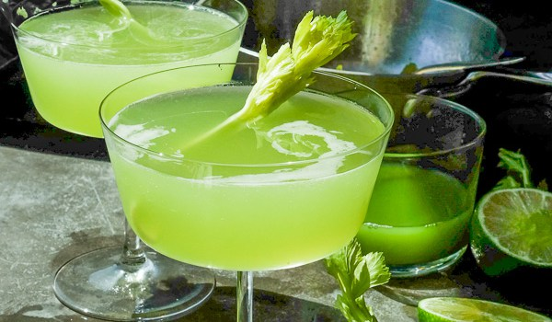
Detoxifying Libation
Consumers opt for food-inspired cocktails that offset the effect of spirits
Healthy Celery Cocktails
This Celery Gimlet Offers a Healthier Alternative to Sugary Drinks

Slide 17
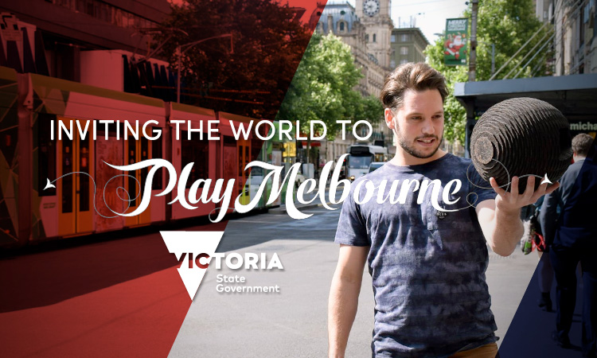
Prosumer Tourism
Influencers infiltrate the travel and tourism space
Livestreamed City Tours
'Play Melbourne Live' Provides a Peek at the City Through Periscope

Slide 18
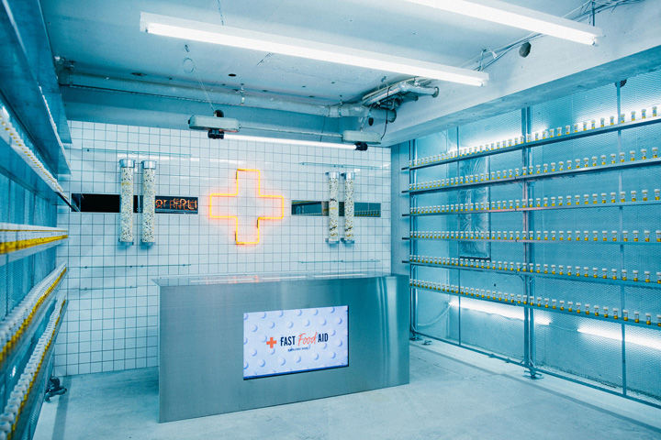
Pretend Pop-Up
Brands capture consumer attention with fake pop-up shop concepts
Faux Fast Food Pop-Ups
This Tokyo Pop-Up is Offering "Fast Food Supplements" for Free

Slide 19
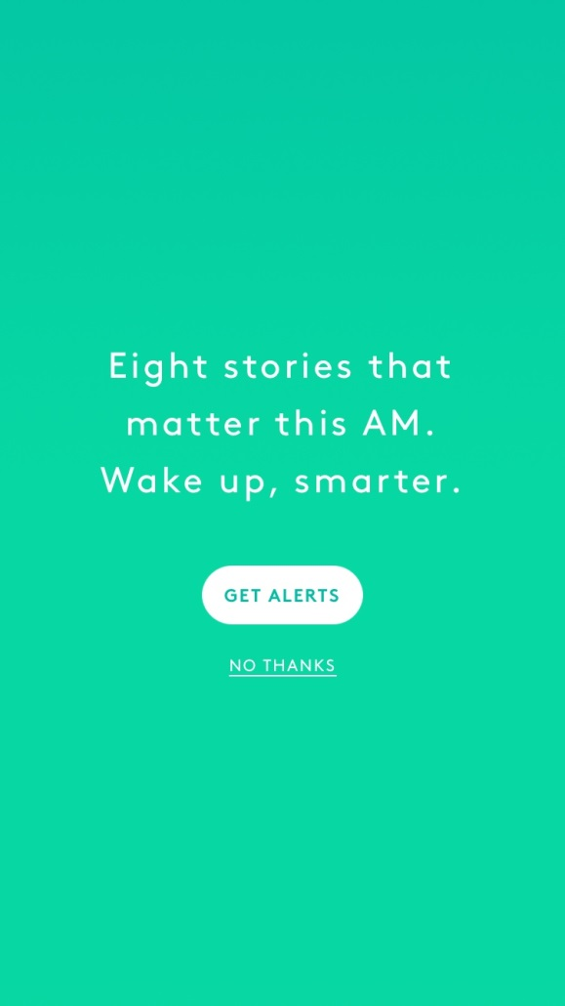
Condensed Broadcast
Consumers prefer short bursts of newsworthy information, not excessive content
Curated Morning News Apps
The 'Refinery29 This AM' App Features Curated News Stories

Slide 20
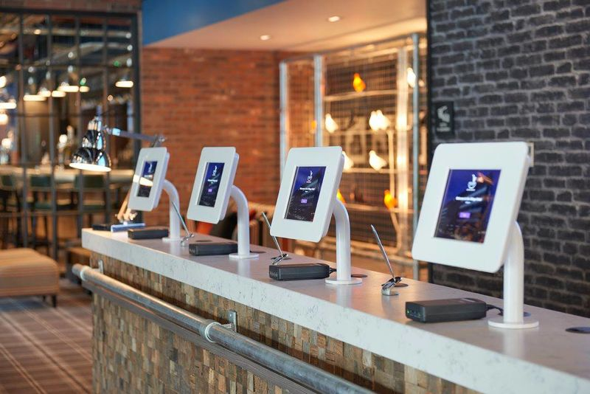
Big Data Concierge
Hospitality brands streamline service with algorithm-based recommendations
Digitized Check-In Kiosks
These Self-Service Hotel Kiosks Replace Concierge Staff

Slide 21
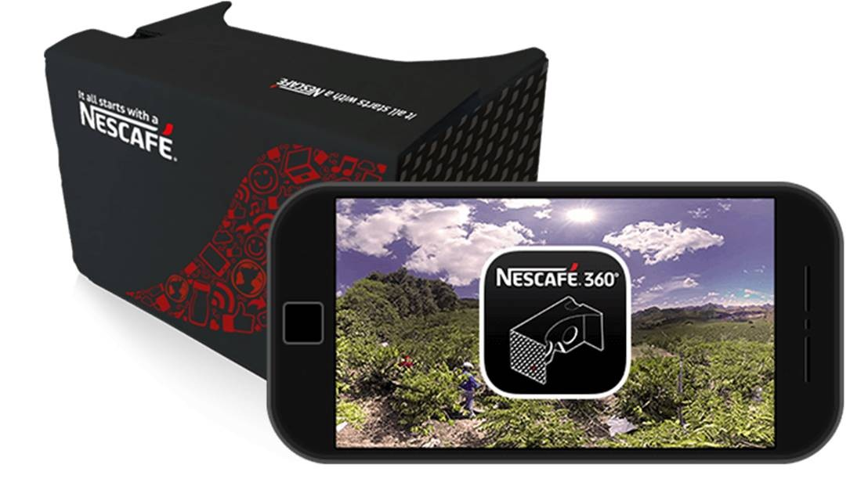
Branded Education
Organizations are boosting transparency by informing customers
Virtual Reality Coffee Tours
This Nescafe 360-Degree Video Showcases International Coffee Growers

