Slide 1
PRESENTATION
PRESENTED BY: FERNANDO WANGILA

Slide 2
BEYOND ALCO-BLOW
Big Data – the new black gold
TIMS
THIRD IDENTIFIER
SMART DRIVING LICENCE
EXISTING INNOVATIONS
FUTURE INNOVATIONS

Slide 3
National Transport and Safety Authority
Keep our roads safe
Welcome Message
National Transport and Safety Authority is a state corporation under the Ministry of Transport and Infrastructure. It was established through an Act of Parliament; Act Number 33 of 2012. The objective of forming the Authority is to:
Harmonize the operations of the key road transport departments which were previously handled by various government departments, Effectively manage the road transport sub-sector and Minimizing loss of lives through road crashes.

Slide 4
ROAD SAFETY PRIOR TO ESTABLISHMENT OF NTSA
Ministry of Transport
Policy Formulation
Infrastructure Development
Ministry of Roads
Transport Licensing Board
Transport Licensing and Regulation
Road Transport Dept/
Registrar of Motor Vehicles
Vehicle Registration and Driver Licensing
National Road Safety Council
Road Safety Education, road safety audit,
road safety research
and road safety data
Vehicle Safety Inspection
Motor Vehicle Inspection Unit
Kenya Revenue Authority
Collection of Revenue
Enforcement of Traffic Laws and driver testing
Traffic Police Department
Identification of PSV’s routes and licensing
of taxis
Ministry of Local Government

Slide 5
TIMS
Introduction
TIMS is a portal based system that incorporates all functions of registration, licencing, inspection and enforcement of all motor vehicles and trailers online. It is designed to achieve the following objectives:-
Eliminate fraud/corruption within the road transport sector
Improve efficiency and effectiveness in resources utilization
Provide single window single source of truth on road transport data
Improve on compliance to traffic rules and enforcement
Improve access and security to information
Integration of all existing heterogeneous databases from the various Transport stakeholders into one Central Data Repository (CDS)
Provide access to shared transport data both through the internet and Mobile technologies

Slide 6
TIMS – My Vehicles

Slide 7
TIMS – DL Driver Offences

Slide 8
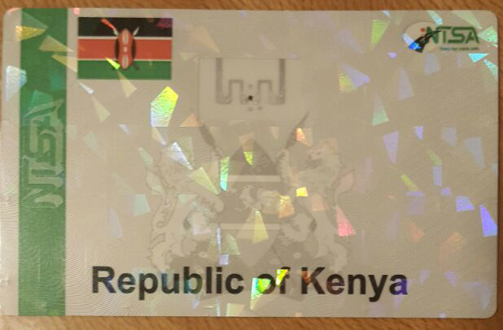
THIRD IDENTIFIER
This is also referred to as the Third License Plate Sticker, which will provide a durable link between the vehicle and the number plate. Help avoid multiple sticks, host all data including insurance in future due to fraudulent river road stickers, vehicles in transit etc
It shall be applied to the inside of the Vehicle’s windscreen. A removal of The Third License Sticker after application to the windscreen shall result in a permanent and visible destruction of the features of the print image and holographic layer.

Slide 9
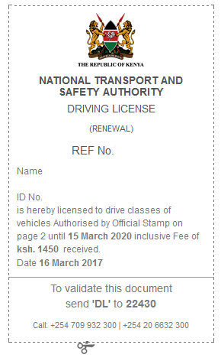
JOURNEY TOWARDS SMART DRIVING LICENSE online DL RENEWAL SLIP

Slide 10
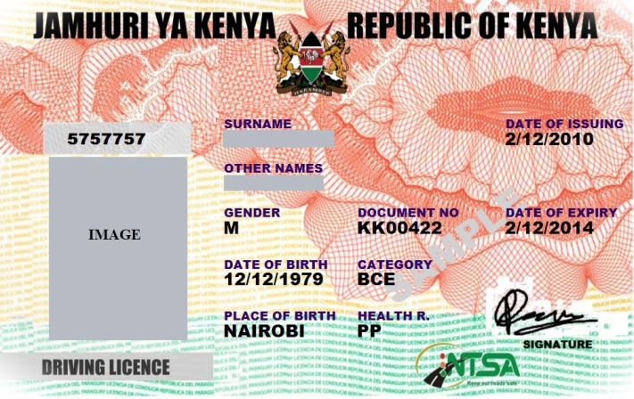
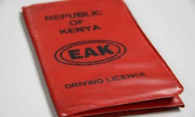
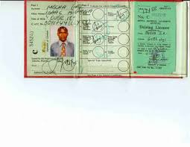
c. Smart Driving License
•The smart driving licences will allow the storage and monitoring of drivers habits and record violations through TIMS.
The licences will have chips containing information such as personal identification number, contacts, past traffic offences, fines previously paid and warnings, and police officers will have devices to read the information and add charge sheets to databases as necessary.
The point system and driver violations will be kept and in conjunction with Insuarance companies it will affect premiums .

Slide 11
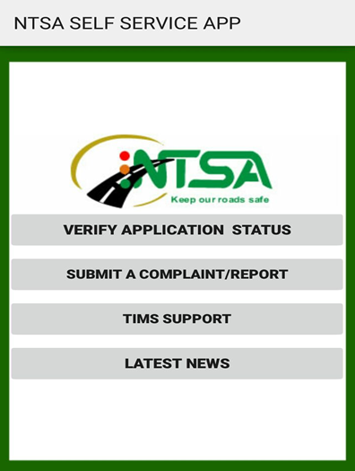
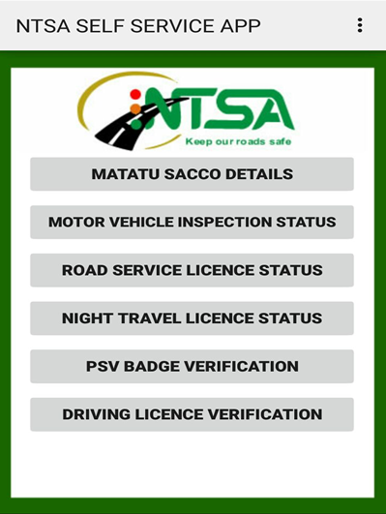
EXISTING INNOVATION NTSA MOBILE APP MAIN MENUS PAGE

Slide 12
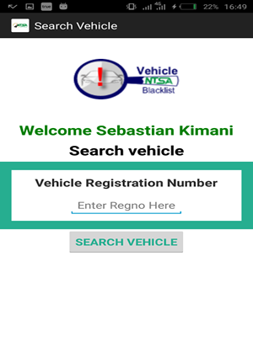
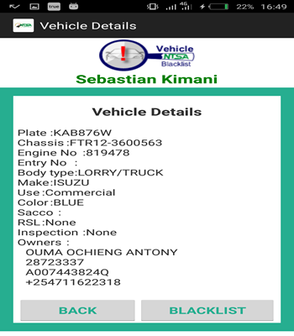
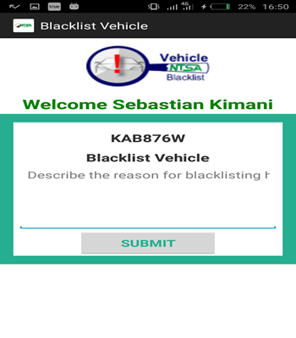
NTSA VEHICLE BLACKLIST APP

Slide 13
Distribution of Fatalities based on Days of the week
ERECTED /ERECTING THE FENCES | EXPRESSED INTEREST
Royal media | Road Track Solutions
Toyota Kenya | Magnate Ventures
AA Kenya | Equity Bank
UAP Insurance | Standard Media
KURA | Outdoor Masters Ltd
National Road Safety Trust(NRST) | Gulf Bank
Nairobi Bottlers | Simba Colt Limited
Atlas Copco | Urithi Housing Cooperative Society
Britam.
Standard Group
Mantrac
VICTIM TYPE | 2016 | 2017 | VAR | % VAR
PEDESTRIANS | 396 | 365 | -31 | -7.8
DRIVERS | 126 | 95 | -31 | -24.6
PASSENGERS | 224 | 235 | 11 | 4.9
MOTOR CYCLISTS | 256 | 252 | -4 | -1.6
PEDAL CYCLISTS | 28 | 15 | -13 | -46.4
TOTAL | 1030 | 962 | -68 | -6.6

Slide 14
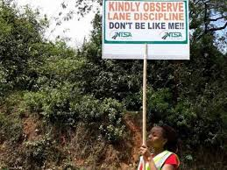
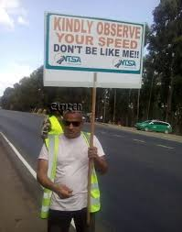
NTSA PLACARD

Slide 15
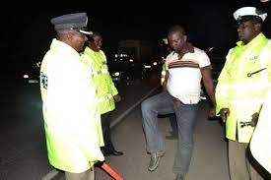
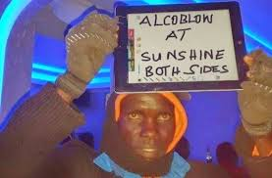
NTSA ALCOBLOW PLACARD

Slide 16
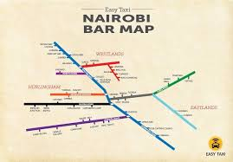
FUTURE INNOVATION NTSA BAR MAP

Slide 17
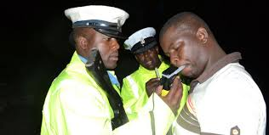
NTSA ALCOBLOW INTERGRATIONS TO HELB

Slide 18
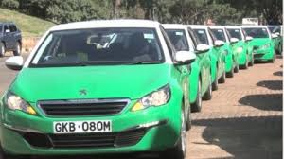
SURVEILLANCE

Slide 19
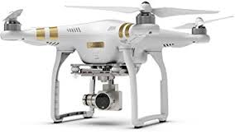
DRONE SURVEILLANCE – Speed, overlapping, spotting blacklisted vehicles, reporting on traffic jam causes – live streaming
DRONE SURVEILLANCE

Slide 20
THANK YOU

